Slide 1


MBIS602 Systems Analysis and Process Modelling
Client Presentation
The group: Group 8
Shi | Cheng | 18991983
Majumder | Sreeta | 27592827
Deng | Yu | 99038839
Ruan | Hang | 83307126

Slide 2
Introduction and Analysis of Scope
LCS Overview
Expansion Opportunity
Christchurch-based firm with more than ten years of profitable operation.
Founded and managed by Ryan Wright.
Established a reputation for expert lawn care services in the residential and commercial sectors.
Initially operated single-handedly with minimum equipment and loyal customers.
Manual processes used for operations, accounts, and customer management
Significant developments contribute to business expansion:
LCS is considering acquiring a nearby lawn care business to grow its customer base, gain new resources, hire more staff, and increase profits.
LCS increases its market visibility in Christchurch, possibly expanding into new residential areas, and increasing competition with local and national competitors.
Ryan explores organic lawn care products to differentiate LCS and attract eco-conscious customers.
Notes:
Good Morning everyone. Today, we’ll be presenting the case of Lawn Care Specialists (LCS), a Christchurch-based business that has been operating successfully for over 10 years. Founded and managed by Ryan Wright, LCS is known for its professional lawn care services, catering to both residential and commercial clients. Recently, Ryan has faced new challenges, including financial pressures from his growing family and an opportunity to acquire another business in the same area. To manage this expansion effectively while maintaining a work-life balance, Ryan is exploring technology solutions to streamline operations and support his growing business.

Slide 3
Requirements Details
Requirement | Priority Status | Priority Category | Implementation Phase
Route Scheduling | High | Essential to Business | Phase I
Customer Management | High | Essential to Business | Phase I
Financial Management | High | Essential to Business | Phase I
Inventory Management | High | Essential to Business | Phase I
Marketing and Online Presence | Medium | Good to Have | Phase II
Forecasting and Planning | Low | Value -Added | Phase II
Adoption of Organic Products | Low | Value-Added | Phase II

Slide 4
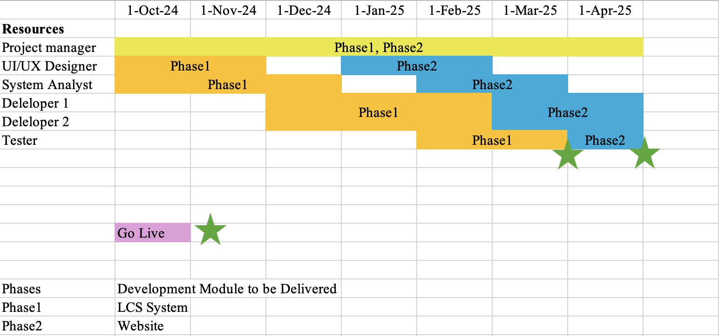
Project Schedule
The project plan is to implement the requirements in 2 phases over a tenure of 7 months as illustrated in Table below. 1st Phase GO LIVE will be on 1st April 2025. Phase 2 as planned GO live will be on 1st May 2025.
The detailed project plan with Gantt chart and detailed tasks of all phases including hiring Developers, UI/UX experts, System Analysts and have been illustrated in Annexure I below.
Project Manager
UI/UX Designer
System Analyst
Software Developers
Tester

Slide 5
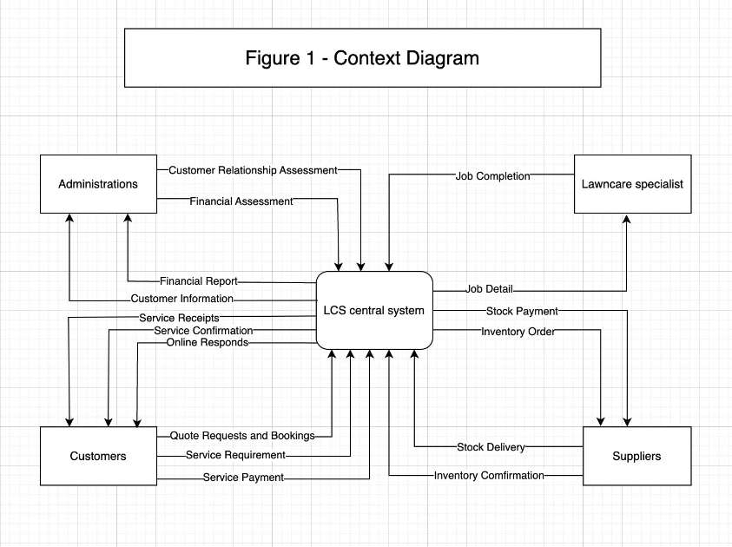
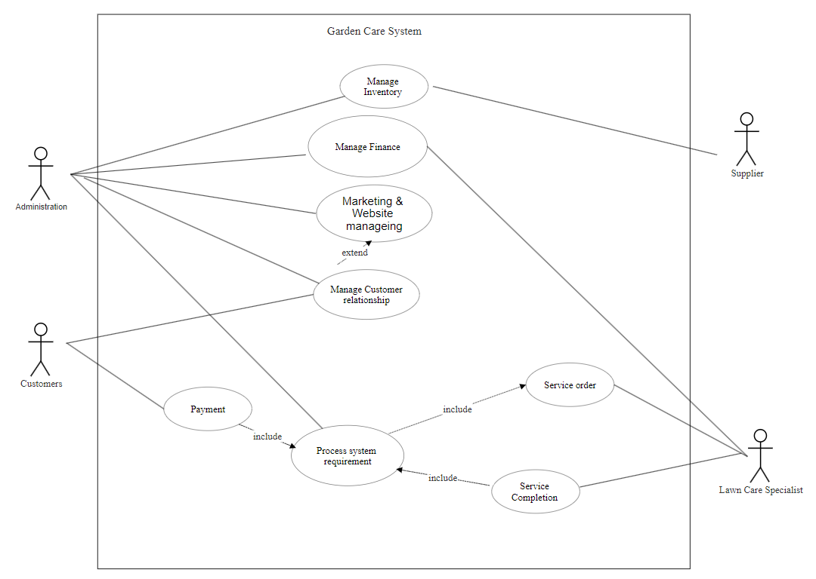
Use Case Diagram
Context Diagram
The context diagram outlines the overview of the organization system. There are 4 entities and one central system. The data flow shows how they interact with each other.
Notes:
The context diagram outlines the overview of the organization system. There are 4 entities and one central system. The data flow shows how they interact with each other.

Slide 6
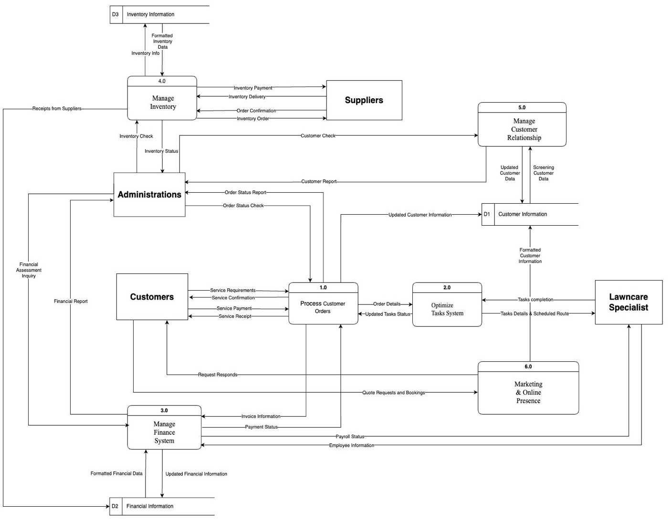
Level 0 Data Flow Diagram (DFD)
The level 0 Data Flow Diagram shows the relationship between all sources. The diagram includes the data flow between four sources, six data processes, and three data stores. In this way, we can know the flow and processing of data input and output interface.
Notes:
The level 0 Data Flow Diagram shows the relationship between all sources. The diagram includes the data flow between four sources, six data processes, and three data stores. In this way, we can know the flow and processing of data input and output interface.

Slide 7
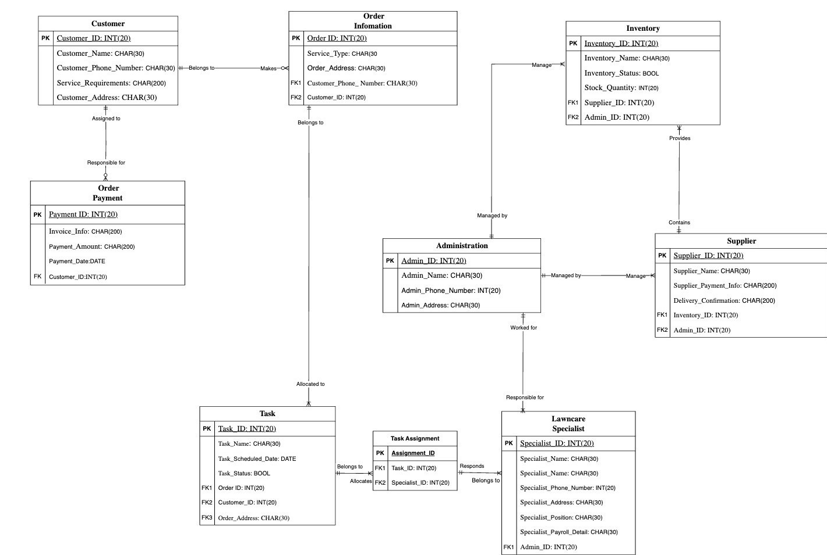
Entity Relationship Diagram (ERD)
The Entity Relationship Diagram shows the entities, their multiplicity and their relationships with each other. The organization of the database can be seen from ERD
Notes:
The Entity Relationship Diagram shows the entities, their multiplicity and their relationships with each other. The organization of the database can be seen from ERD

Slide 8

Prototype
Login Page
https://www.figma.com/proto/UTPorm1C9i8WJLgzdZi9th/Dashboard-UI-Kit-with-Prototyping-(Community)?node-id=1879-62222&t=hsbjZQWT5apG1phk-1
Notes:
Based on our system requirements analysis, we created initial system prototypes using Figma based on DFD, ERD and other logical designs. These prototypes are real and clickable, below is the URL of the prototype. Now, let's take a look at some of the major functional pages.
Firstly, The login page. This page provides secure access to the system for both administrators and employees. Depending on the user, the permissions can be different. For example, administrators can use the function of assigning tasks, while employees cannot. It ensures that only authorized users can access sensitive data.
It has some key Features:
1. “Remember Me” Feature: It Enhances user convenience by allowing users to stay logged in without repeatedly entering credentials.
2. Forgot Password: This can Provides an option for password recovery, ensuring smooth access even if users forget their login details.

Slide 9
Prototype
Admin
Dashboard Page
Notes:
After logging in, We can see this Dashboard Page. This page serves as the central command center for Ryan and his employees, providing an overview of the business's key metrics, financial performance, tasks, and inventory status in real-time.
There are 6 functions on the left side, which are Dashboard, Task & Fleet, Invevntory, Customer, Financial Management, and Web Presence.
As you can see, the Dashboard contains these main features：
1. Financial Summary: Provides Ryan with real-time insights into revenue, expenses, net profit
2.Upcoming Tasks & Inventory Status: Displays scheduled services and inventory levels to help decision-making.
3.Quick Access: Shortcuts for route scheduling, customer management and others
4.Performance Metrics: Shows detailed performance data, helping Ryan track the business's financial health, task completions, and profitability.

Slide 10
Prototype
Task and Fleet Management Page
Notes:
This is Task and Fleet Management page
This page is designed to optimize employee task assignments and fleet management, crucial for efficient operations in the lawn care business.
Key Features:
Task Assignment: Shows a clear schedule of tasks assigned to employees, including the service location, time, and status
Route Scheduling Map: Uses GPS to optimize routes for employees, reducing travel time and increasing operational efficiency. The feature allows Ryan to view the total distance and estimated time for each route, ensuring timely services
Fleet Maintenance: Displays upcoming maintenance tasks for the fleet, ensuring vehicle readiness and minimizing downtime.
All these designs meets the Route Scheduling requirement

Slide 11
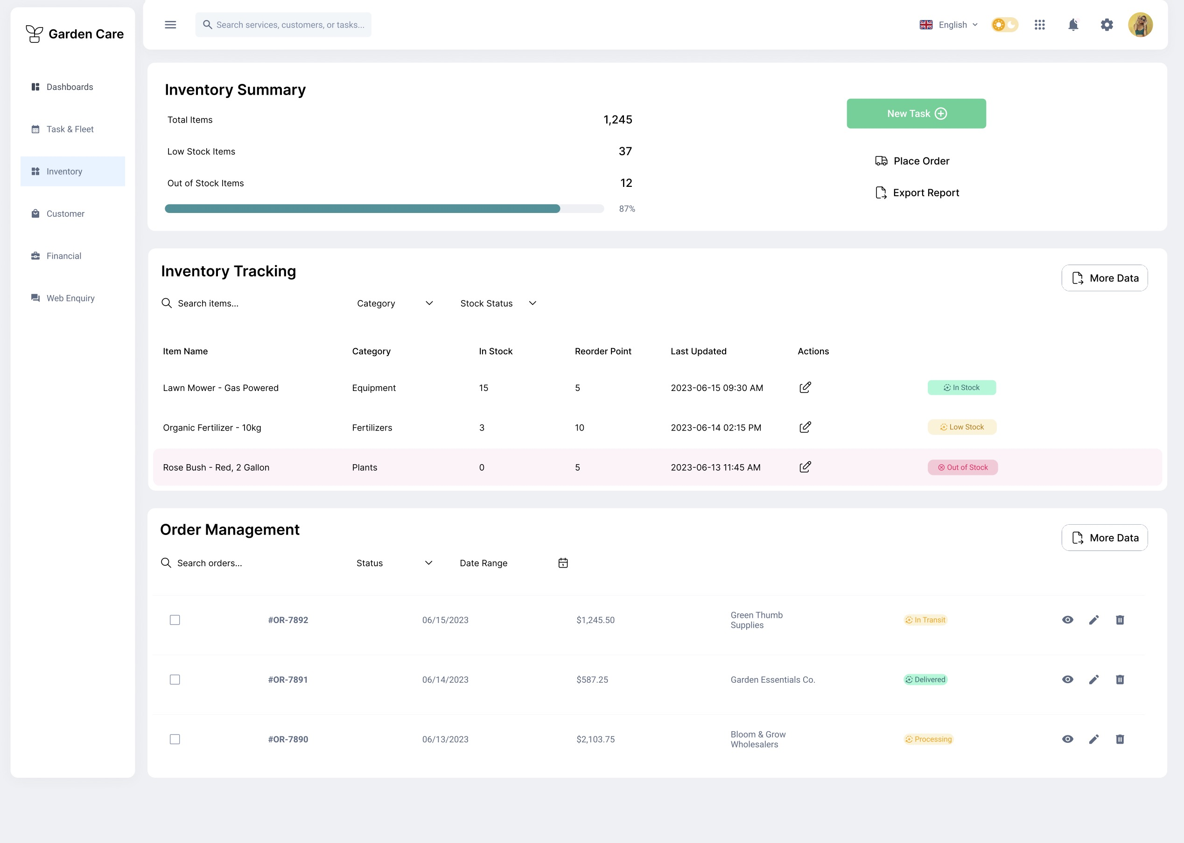
Prototype
Inventory Management Page
Notes:
This is Inventory Management page
This page enables LCS to efficiently track and manage inventory, including tools, equipment, and materials needed for lawn care services.
Key Features:
1.Inventory Summary: Provides an overview of available items, low stock, and out-of-stock items, ensuring timely reordering of necessary supplies.
2.Inventory Tracking: Tracks categories, stock status, reorder points, and last updates for specific items, ensuring the right materials are always on hand.
3.Order Management: Displays past orders, their status, and actions required , helping Ryan to streamline supplier management.
All these designs meets the Inventory Management requirement

Slide 12
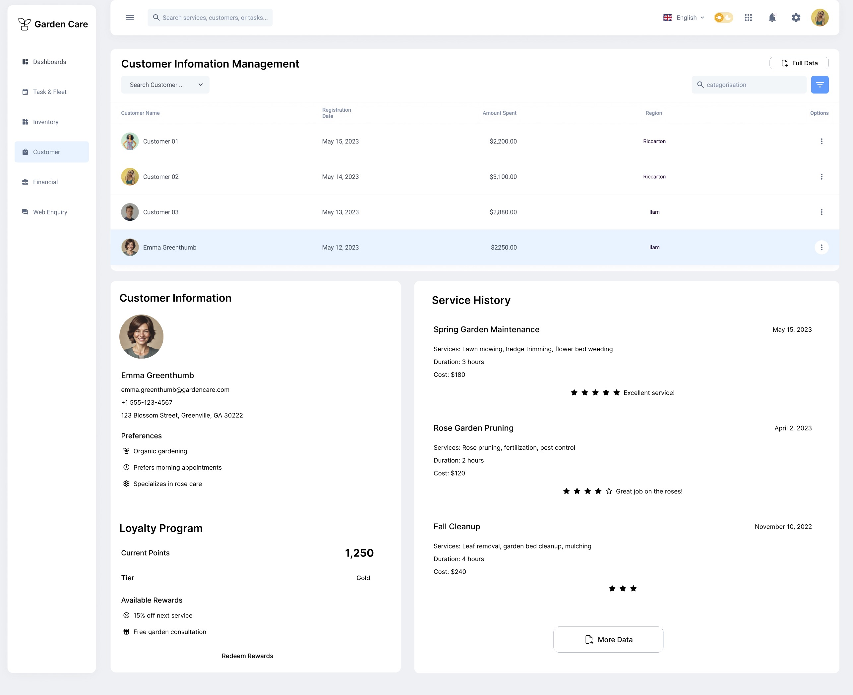
Prototype
Customer Management
Notes:
This is Customer Management page
This page allows LCS to maintain comprehensive records of clients, service histories, and preferences, enhancing customer relationships and service personalization.
Key Features:
Customer Information Management: Displays detailed customer profiles, including contact details, service preferences, and the amount spent
Service History: Shows each customer’s service history, ratings, and feedback, helping LCS maintain high service quality and adjust offerings based on customer feedback.
Loyalty Program: Displays customer loyalty points and available rewards, encouraging repeat business and fostering customer loyalty.

Slide 13
Prototype
Financial Management
Notes:
This is Financial Management page
This page automates and tracks LCS's income, expenses, payroll, and invoicing, offering Ryan a clear understanding of the company's financial health.
Key Features:
Revenue and Expense Tracking: Provides detailed insights into revenue, total expenses, and net profit, helping Ryan make informed business decisions.
Payroll Tracking: Displays payroll information for employees, ensuring timely and accurate payments.
【Click】-------
Invoice Tracking: Allows Ryan to generate and track invoices, improving payment collection and automating accounting processes.
All these designs meets the Financial Management requirement.

Slide 14
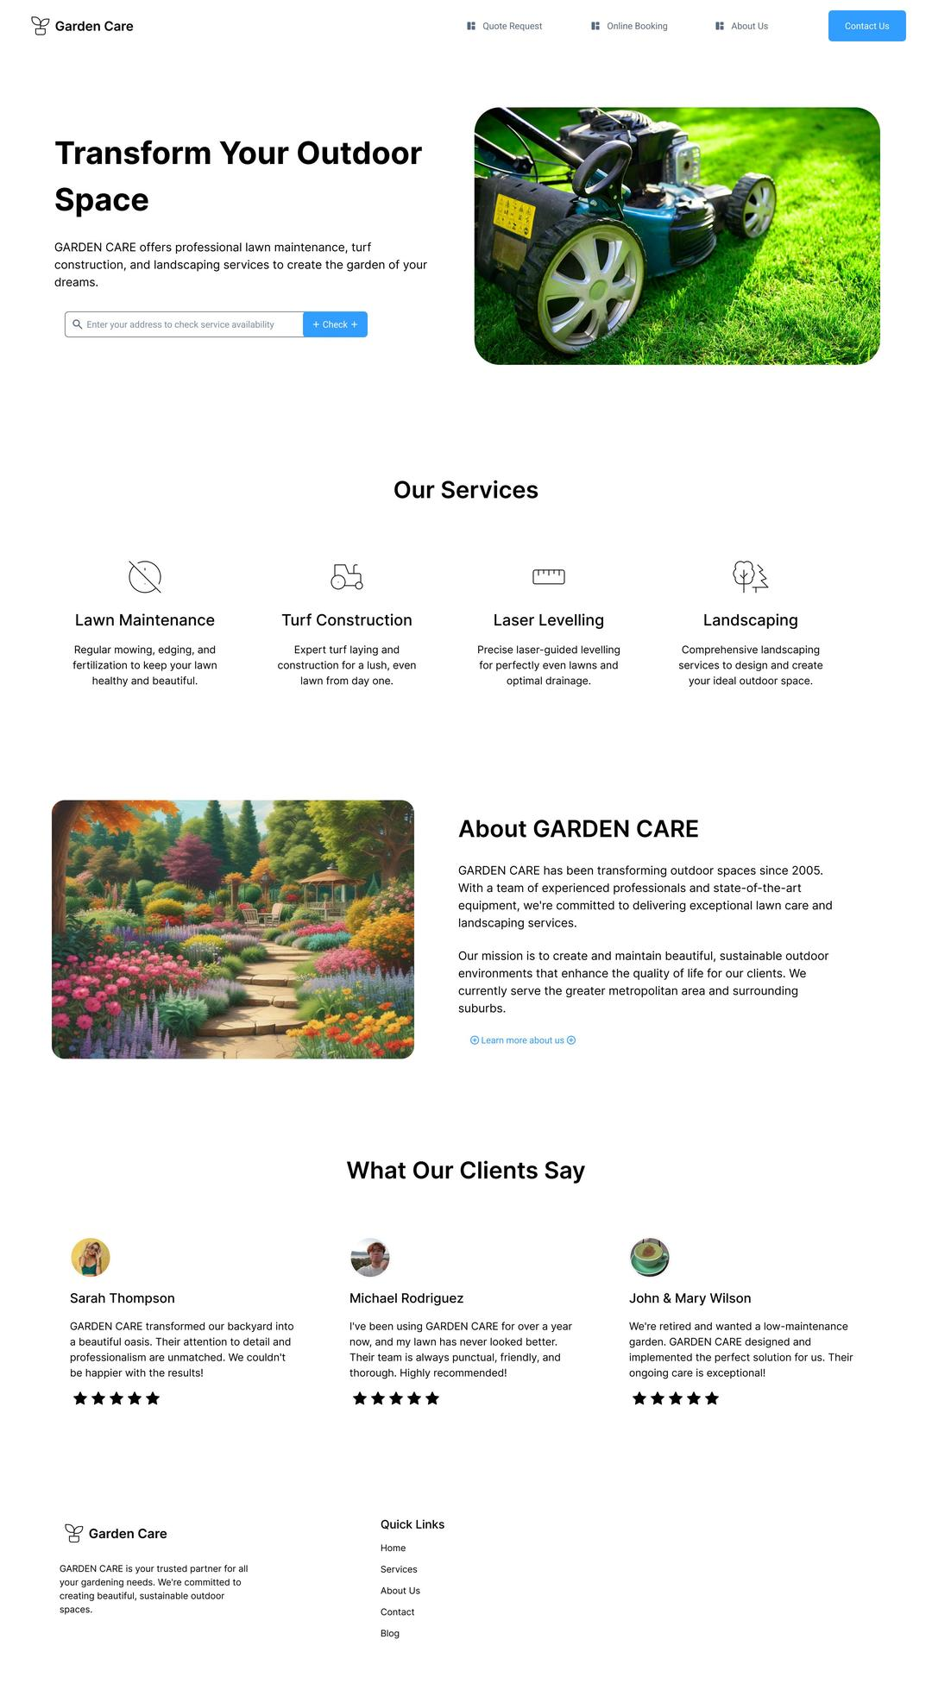
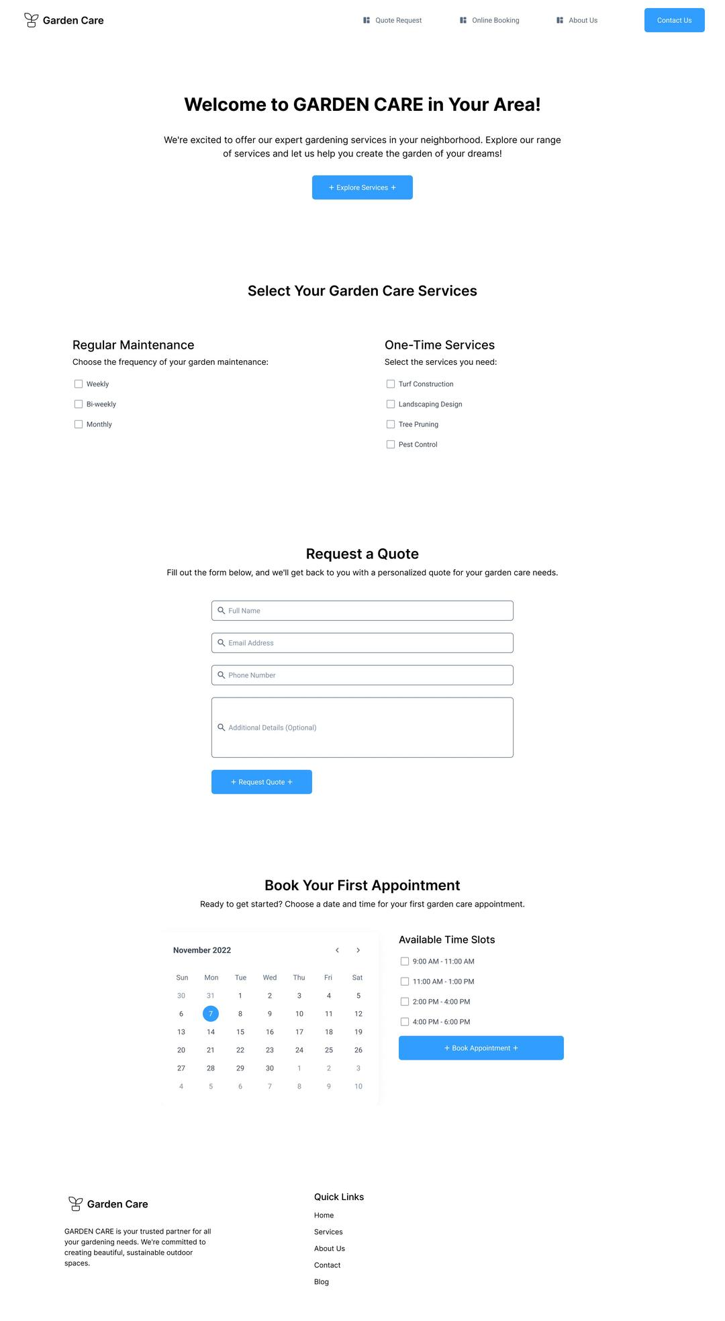
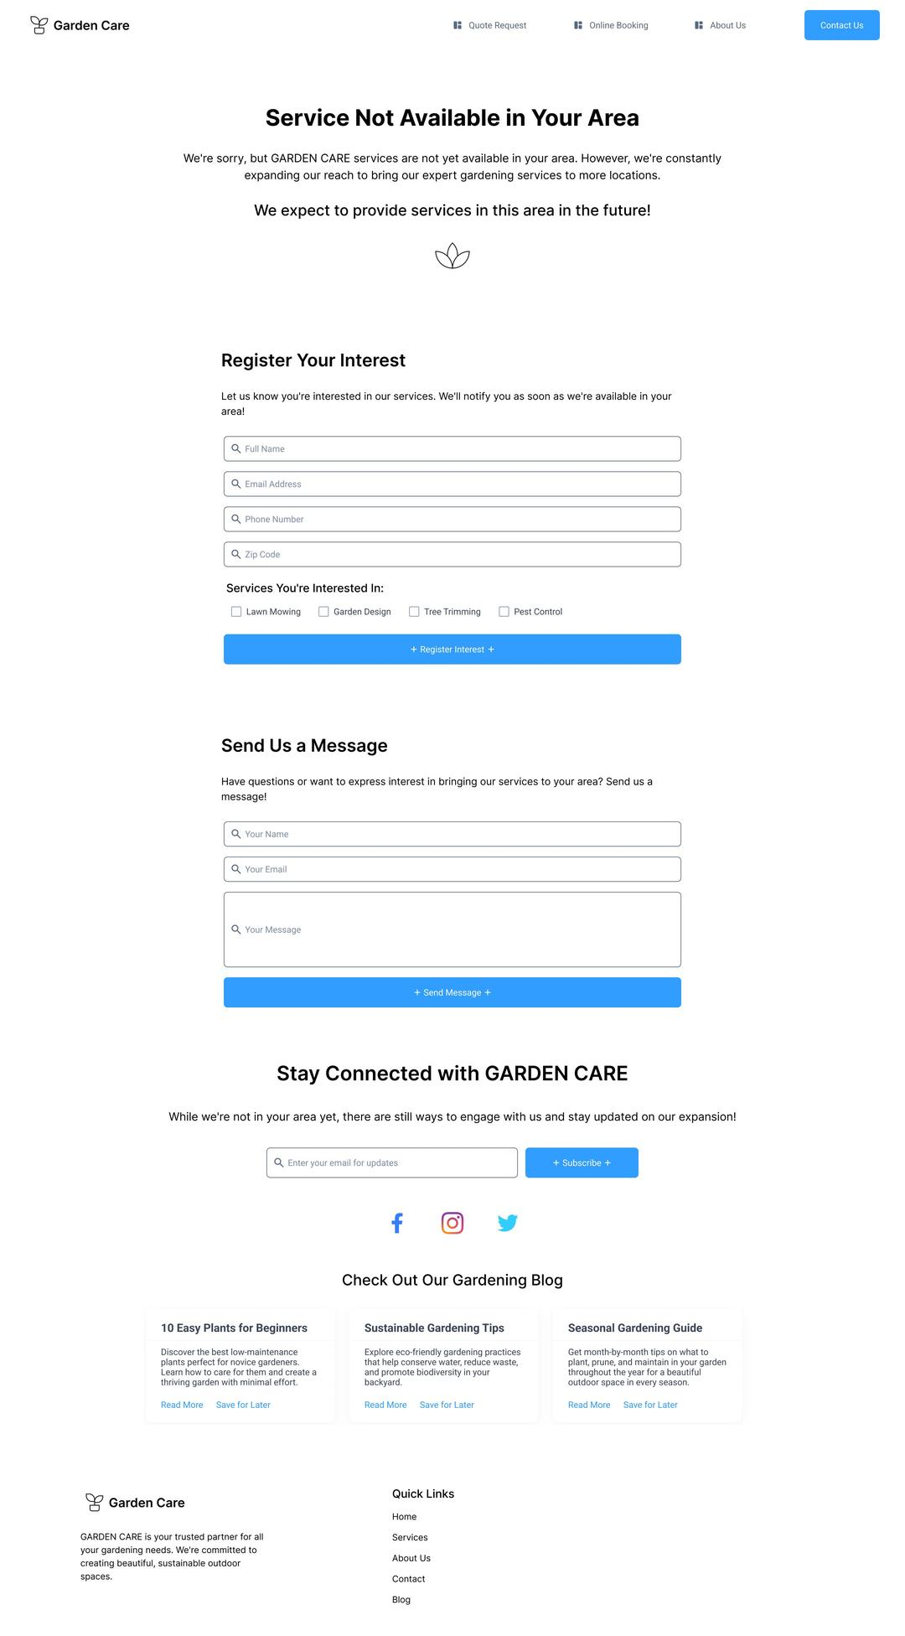
Prototype – Web Presence
Website – Main Page
Website – Service Page
Website – Out of Area Page
Notes:
Finally, for Online Presence, we created an official website. This website presents a professional image and attracts more potential users.
The site begins with a concise introduction(1.1), current scope of business(1.2) and customer stories(1.3).
And Here, We provided an address checker(1.4). Users can enter their address. The system will automatically detect if the address is within the current operating area.
If it is within the area of operation, they are taken to the services page.(2) This page provides quote request and online booking functionality.
If it is not in the operating area, it goes to the Out of Area page (3), which displays ‘Service is not available in your area’ and provides user demand registration and message functions. This information is sent to the database for future business expansion to refer to.

Slide 15






Recommendation of a Solution
Objective
Analysis of Pros and Cons of Buy and build
To implement a comprehensive integrated software solution to improve operational efficiency and enable future expansion.
Pros
Lower Upfront Cost: Off-the-shelf software typically has lower initial costs.
Less Waiting Time: Ready-to-use software facilitates fast implementation.
Cost Efficiency: Reliable software are generally cost-effective in the long run.
Lower Maintenance and Training Costs: Credited software offers long term support.
Free Updates: New features and updates are included without less cost.
Cons
Customization requirements: Ready to use solutions may need customization, resulting higher costs and longer implementation times.
Limited functionalities: The software may not fully meet all specific needs.
Integration difficulties: New software may have compatibility issues with existing systems.
Key Functionalities
GPS Guided Route Scheduling
Real-time task optimization
CRM
Financial Management
Inventory Management
Software integration
Acquisition Approach
A combination of building and buying is recommended. The core functionality can be built in-house, while specialized modules can be purchased from third-party vendors.
Estimated Cost
Build: The estimated cost of the software is $$248,800, including development, implementation, and ongoing maintenance
Buy: Buy from credited supplier for up to $30,000
Combination: Up to $80,000 to $100,000
Recommendations
A solution include route scheduling, CRM, financial management and inventory management with combination acquisition approach.
Purchase ready to use software from reliable and reputable providers for fast deploy time and in use for CRM, financial management and inventory management.
Joint venture to develop a route scheduling software with tasks optimization.
Choose iterative development method.

